Slide 1

Tic-Tac-Q
Amaia
Ane
Iván
Mikel
Rubén

Slide 2
What do we want?

Slide 3


Slide 5
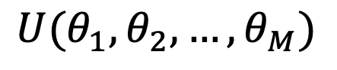
Quantum Born Machine
$$U(θ_{1}, θ_{2}, …, θ_{M})$$

Slide 6
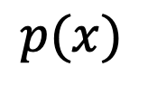
Quantum Born Machine
$$p(x)$$
$$U(θ_{1}, θ_{2}, …, θ_{M})$$

Slide 7
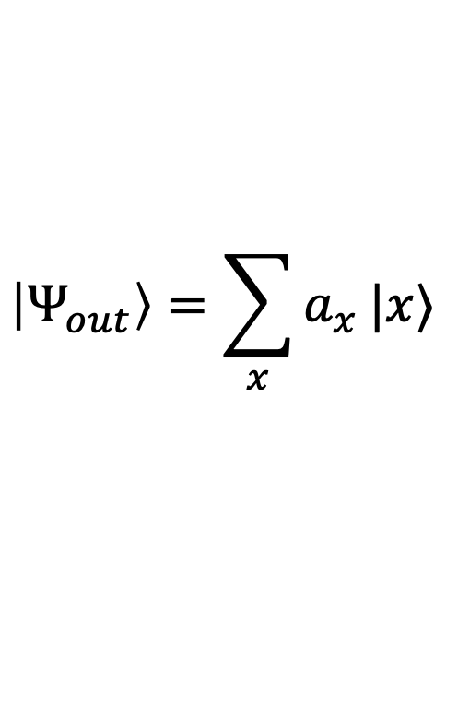
Quantum Born Machine
$$p(x)$$
$$\left|Ψ_{out}\right\rangle =\sum_{x}{a_{x}}|x⟩$$
$$U(θ_{1}, θ_{2}, …, θ_{M})$$

Slide 8
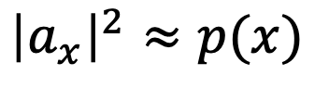
Quantum Born Machine
$$p(x)$$
$${\left|a_{x}\right|}^{2}≈p(x)$$
$$\left|Ψ_{out}\right\rangle =\sum_{x}{a_{x}}|x⟩$$
$$U(θ_{1}, θ_{2}, …, θ_{M})$$

Slide 9
What we have done?

Slide 10
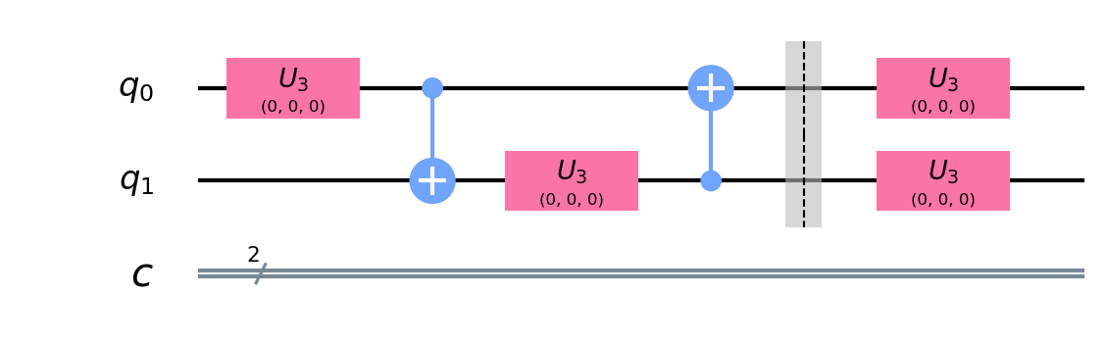

Slide 11
X | P(x)
|00> | 0.5
|01> | 0.2
|10> | 0.2
|11> | 0.1

Slide 12



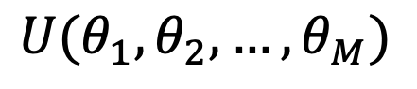

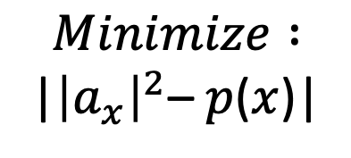
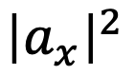
$$Trial$$
$$Final$$
$$(θ_{1}, θ_{2}, …, θ_{M})$$
$$(θ_{1}, θ_{2}, …, θ_{M})$$
$$Minimize :$$
|${\left|a_{x}\right|}^{2}$– $p$($x$)|
$${\left|a_{x}\right|}^{2}$$
$$U(θ_{1}, θ_{2}, …, θ_{M})$$

Slide 13
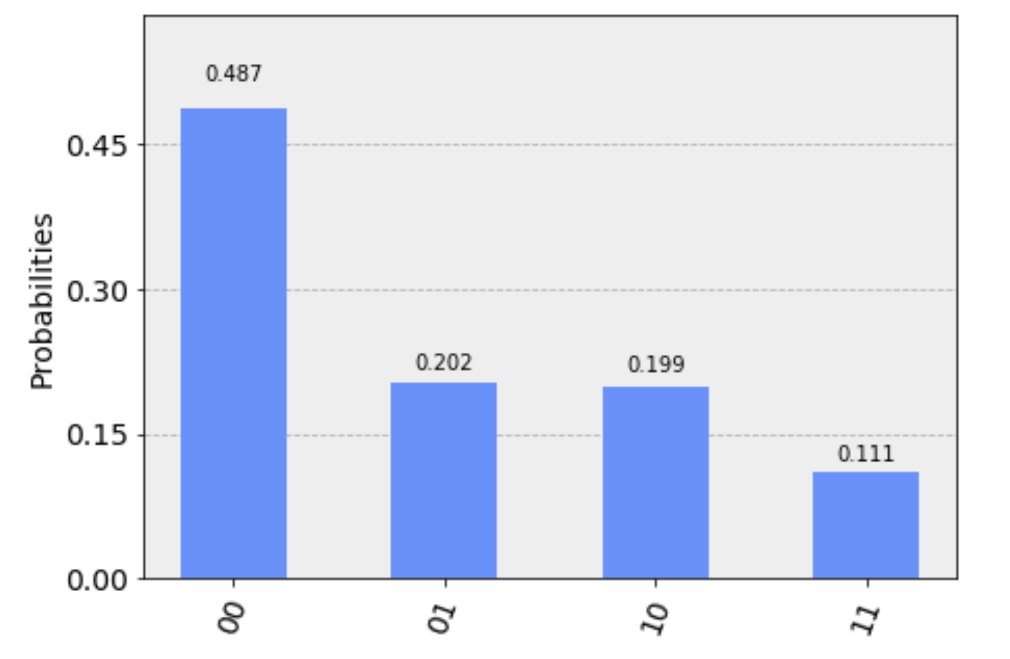
Comparison obtained probability distribution
X | P(x)
|00> | 0.5
|01> | 0.2
|10> | 0.2
|11> | 0.1
0.487
0.202
0.199
0.111

Slide 14
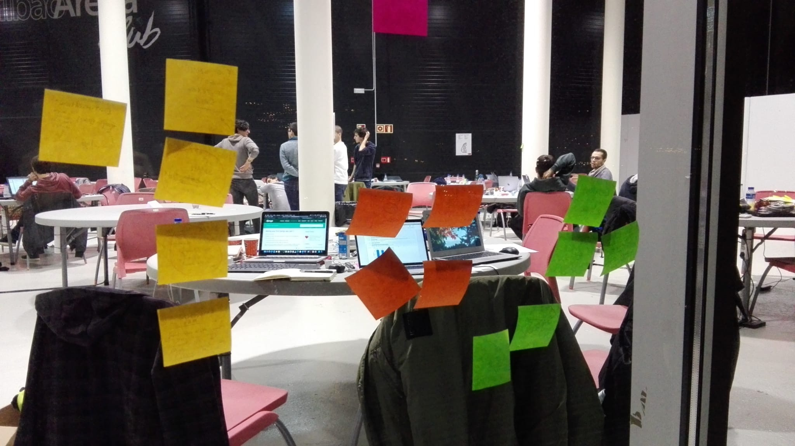

Slide 15

QBM

Slide 16
Obtained results
Wins
Wins
Failures
Failures

Slide 17
Parameters increasing effectiveness of the tuning
Parameter
max_iter
max_error
step
X_0

Slide 18
Future line of work
Modify parameters for better results
Add blank state to the cells
Experiment with smaller training sets

Slide 19
Summing up
We wanted a QBM to generate winning solutions for Tic-Tac-Toe
We developed a 9-qubit circuit optimized to replicate a desired behaviour
We would like to continue the future line of work mentioned above

Slide 20
Tic-Tac-Q
Amaia
Ane
Iván
Mikel
Rubén
Thank you!
Mila esker!

